Slide 1
Distilling from Twitter: New Perspectives in Healthcare Organizations Using Association Rule Mining
Aditya Singhal
Group: 34
Course: (2023W) COMP-5112-WA - Research Methodology Comp Sci

Slide 2
CONTENTS
Main Objectives
Research Overview
What is Association Rule Mining?
Data Set
Pre-processing
Itemsets and Association Rules
Graphical Visualizations
Quantitative Analysis
Principal findings and Conclusions

Slide 3
Objectives:
Examine Twitter usage by US and Canadian health agencies and pharmaceutical companies
Identify text patterns influencing the tweets' content.

Slide 4
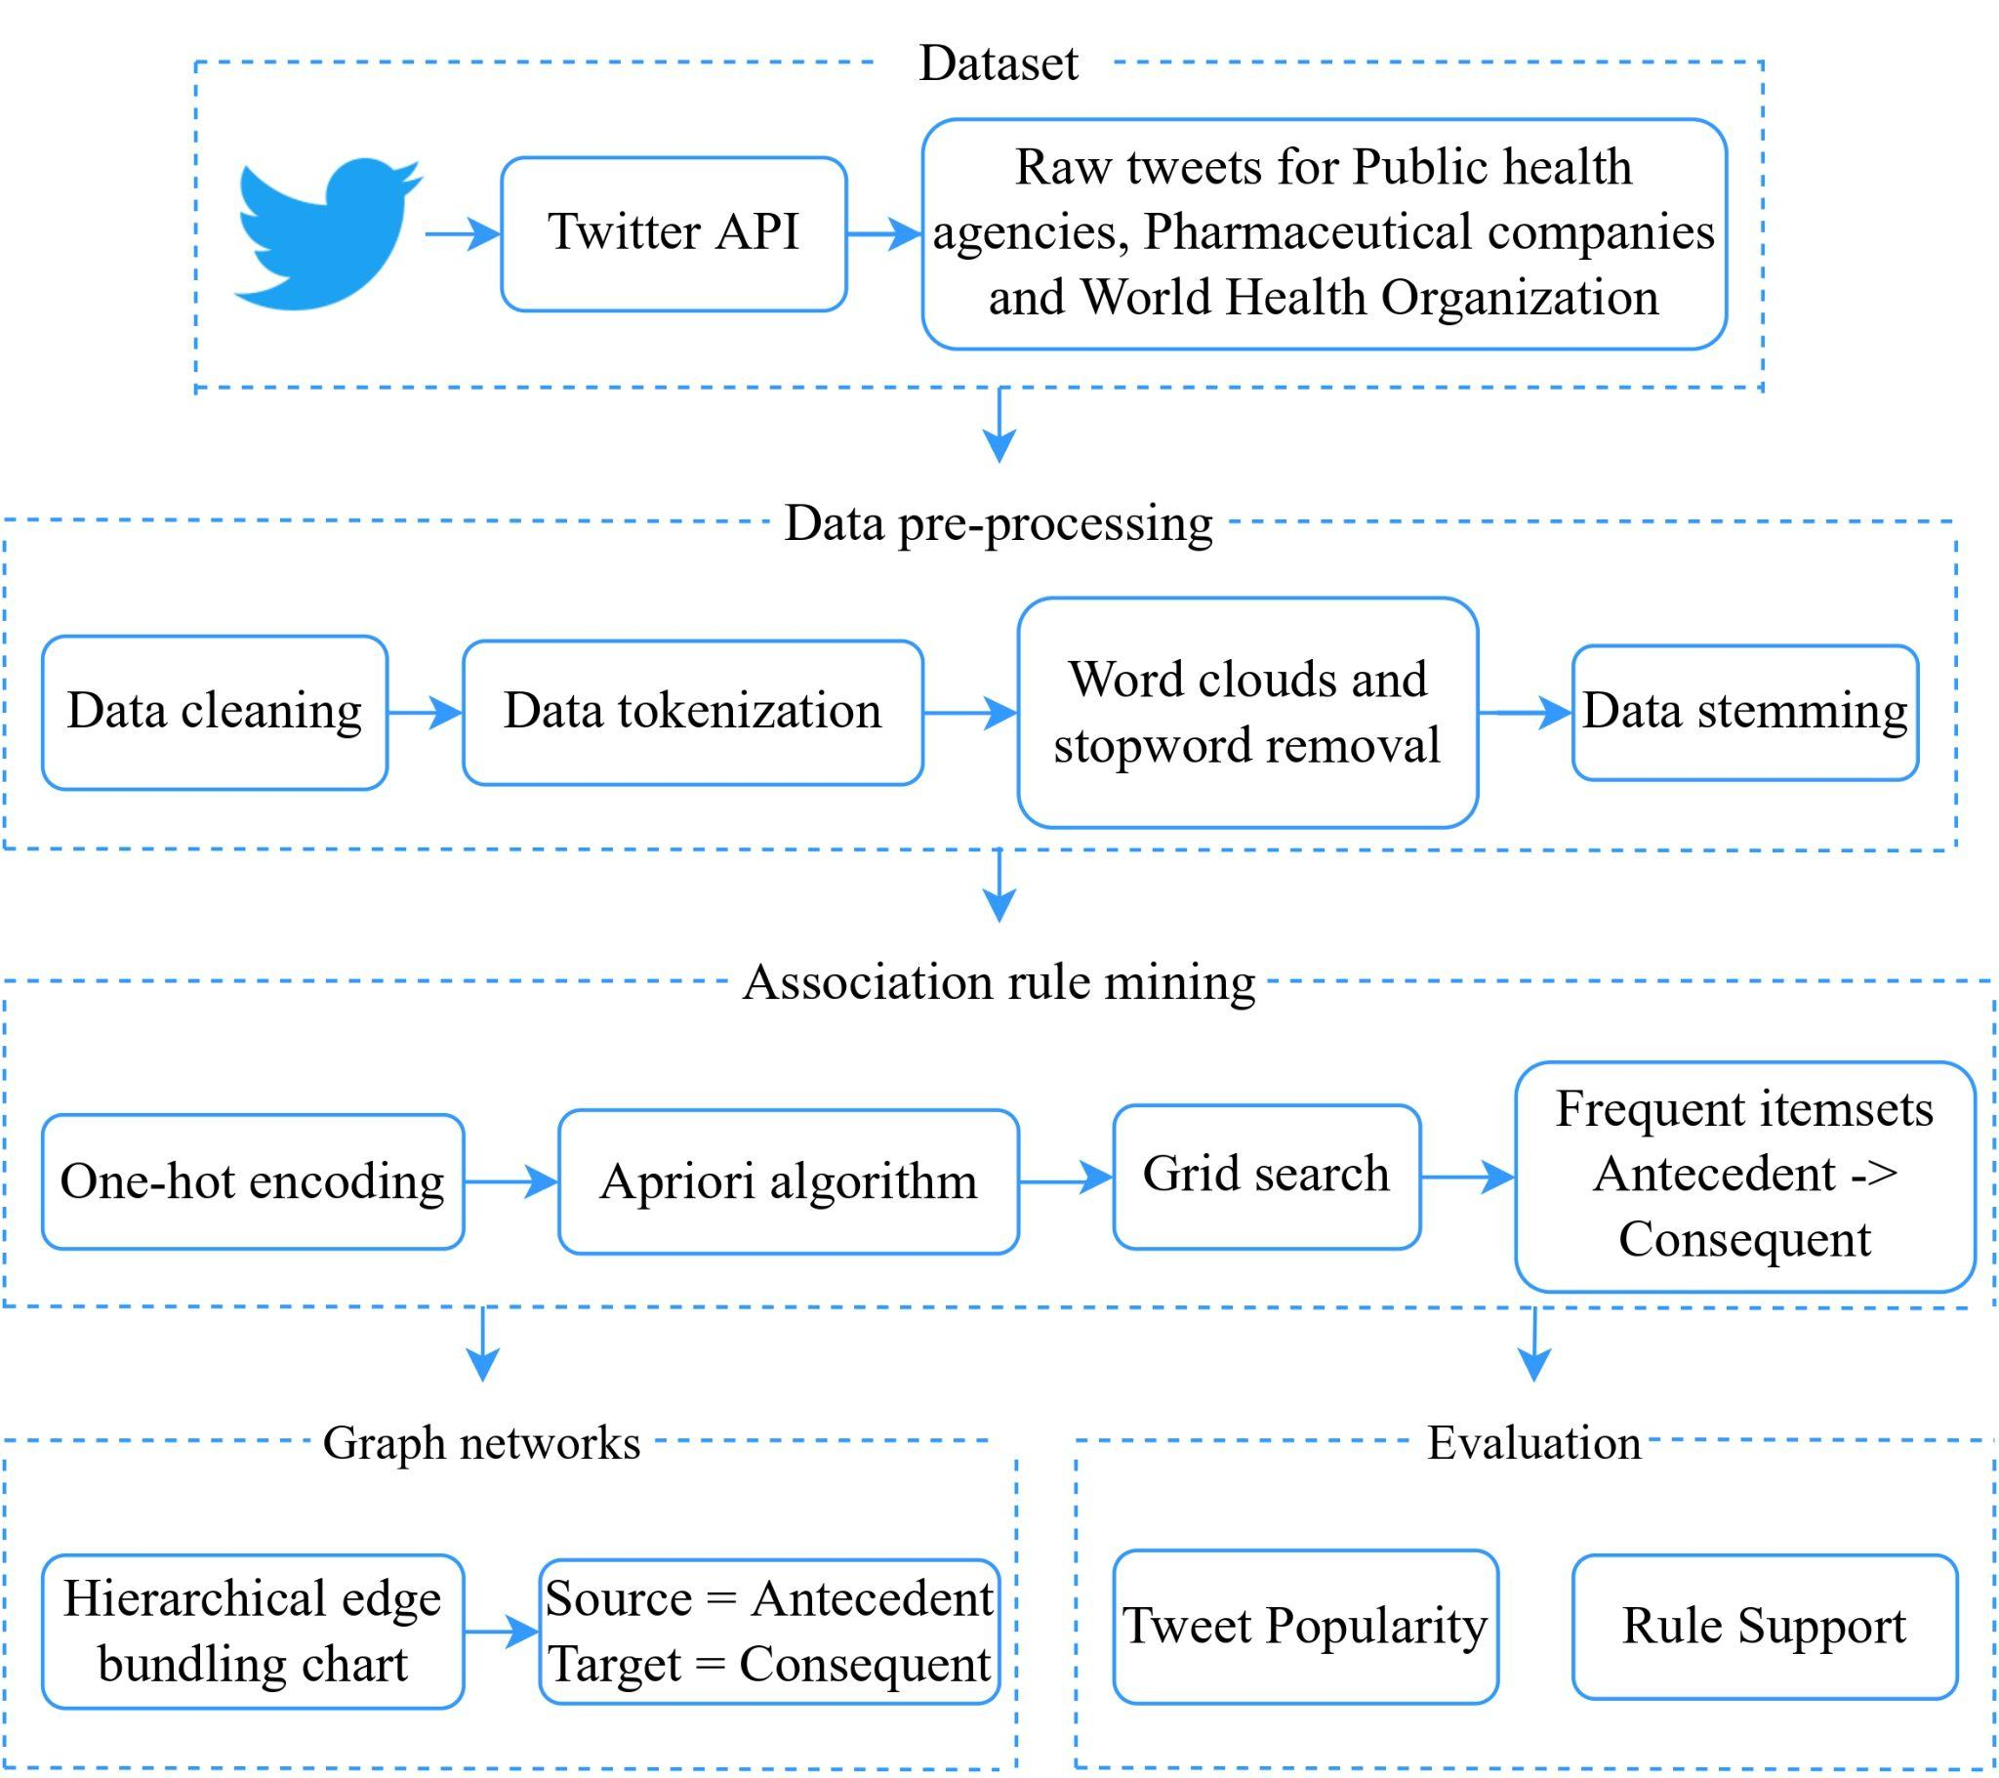

Slide 5
Association rule mining is a rule-based machine learning method for discovering interesting if/then statements that help uncover relationships between variables in large databases.

Slide 6
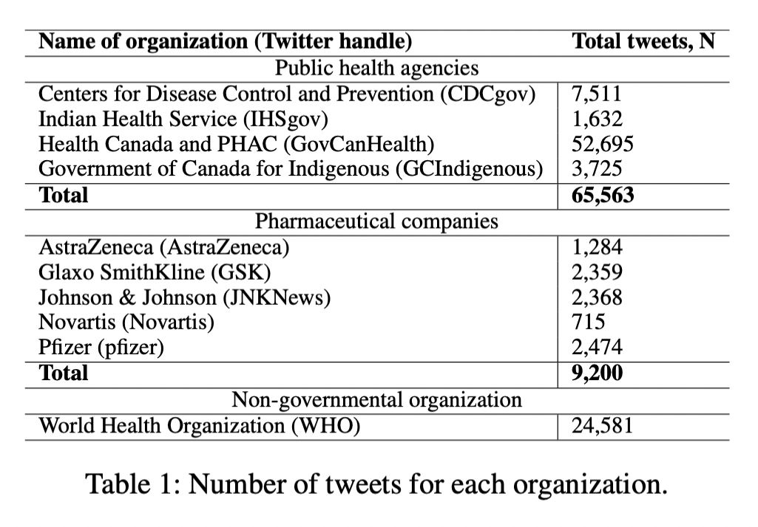

Data Set
https://creation.co/knowledge/top-50-pharma-tracker-hcps-share-mixed-opinions-on-covid-19-vaccines-and-treatment-data/

Slide 7
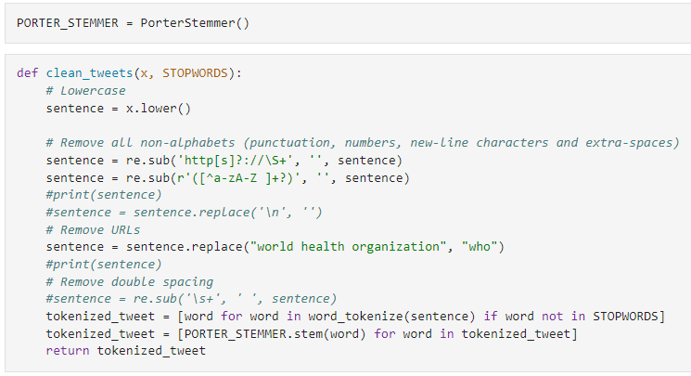
Pre-processing

Slide 8
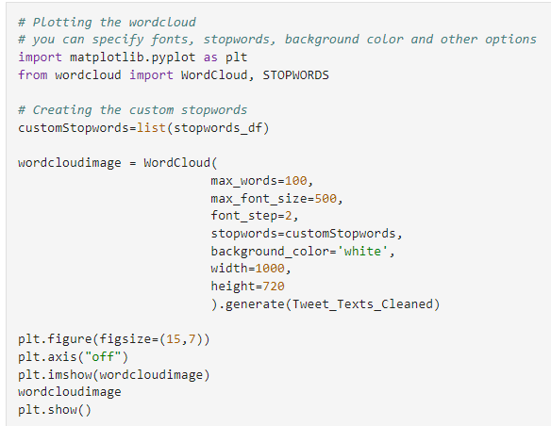

Slide 9
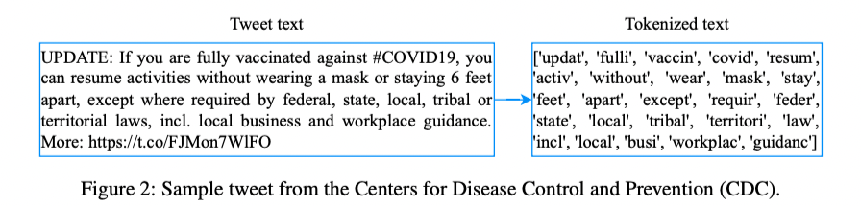

Slide 10
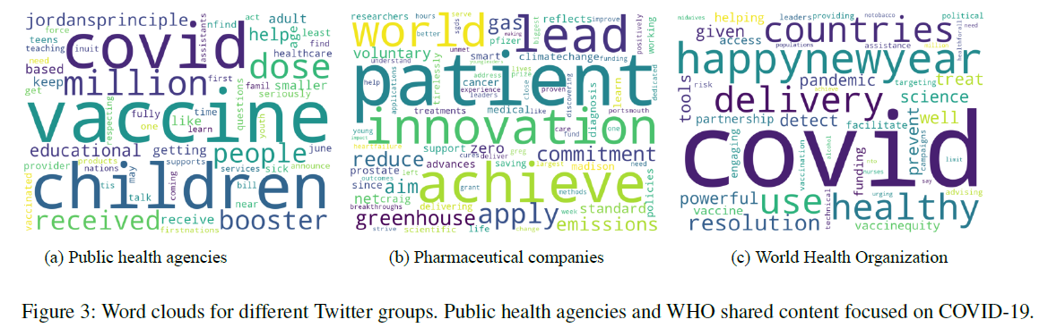

Slide 11
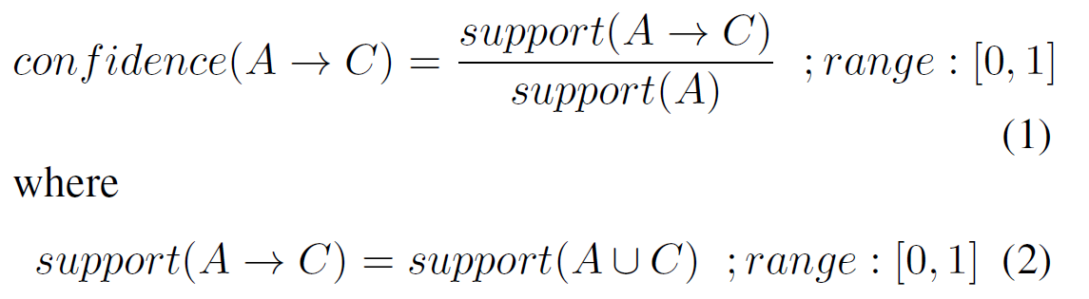
Mlxtend python library for ARM
Data set is encoded in the form of Numpy arrays using TransactionEncoder() API.
Using fit and transform methods, the input data is transformed into a one-hot encoded Numpy boolean array
Generate rules of the form X→Y by performing a grid search, where X is the antecedent and Y refers to the consequent. To find an interesting rule, we calculate the confidence metric
Language use and Style using Itemsets and
Association Rules

Slide 12

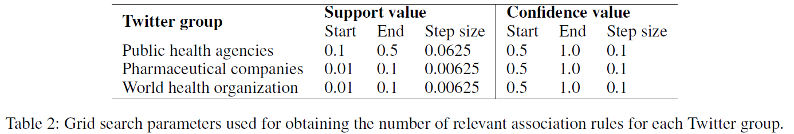
Lift metric to filter rules having statistically independent antecedents and consequents, i.e., lift ≥ 1.

Slide 13
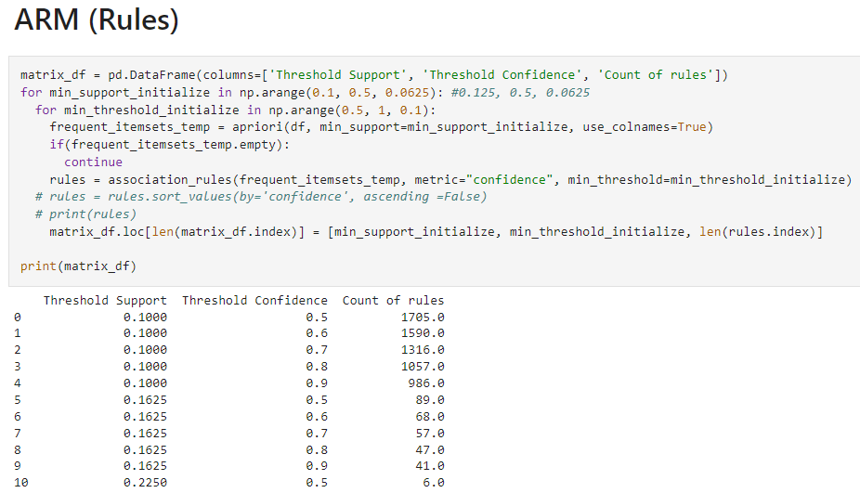

Slide 14
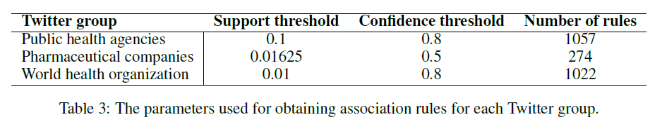
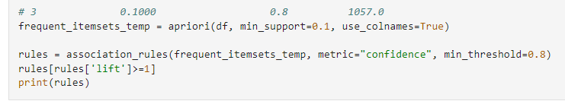
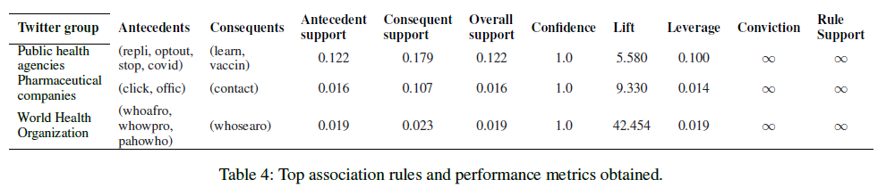

Slide 15
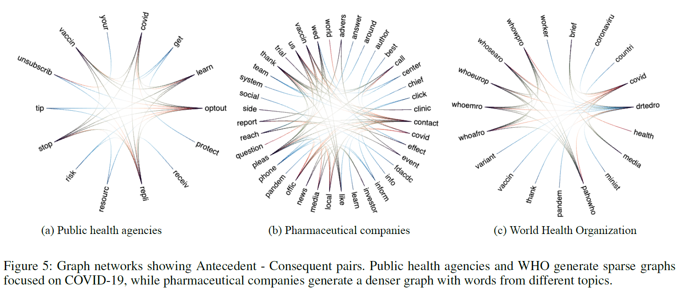
We create a hierarchical edge bundling chart (d3js library) where
Source = antecedents and Target = consequents
Graphical Visualizations

Slide 16
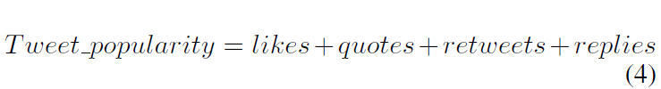
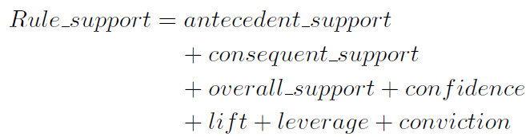
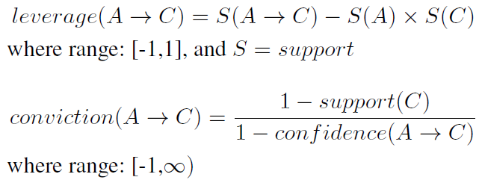
Quantitative Analysis using Evaluation Metrics

Slide 17
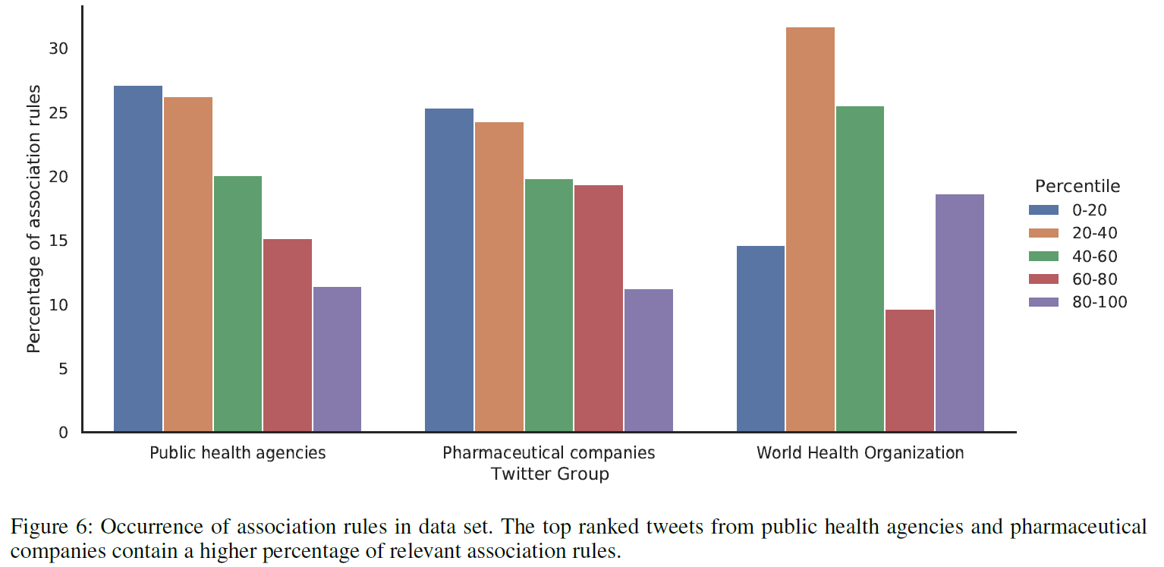
Frequency of occurrence of association rules in the top 10%
of tweets is calculated, and the results obtained are plotted:

Slide 18
Building a reputation goes beyond just evaluating a tweet’s popularity in the online sphere.
Language use and style across the Twitter groups impacts public engagement.
The association rules, which are mined from existing content, can be utilized to structure future tweets’ content to ensure maximum public engagement.
Principal Findings & Conclusion

Slide 19
Thank you!
Any questions?

